Slide 1
͢
Level sets of L(β)
v
-∇L(β)
-∇L(β)
β₂
-∇L(β)c
β₁

Slide 2
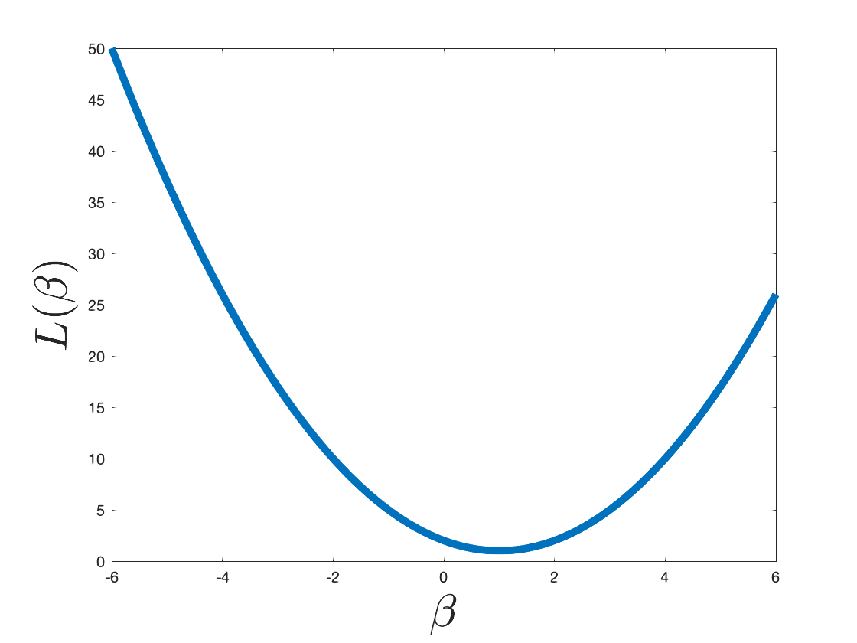
L(β₂)
L(β₁)
β₁
β₂

Slide 4
d features
1
1
...
n examples
...
age
BMI
sex
1
X

Slide 5
y
x

Slide 6
x
✓
✓

Slide 7
This is a sentence.
1
1
1
1
a
aardvark
zyzzyva
zoo

Slide 8
This is a sentence.
1
1
1
“a sentence”
“is a”
“this is”

Slide 9
This is a sentence.
1
1
“is a sentence”
“this is a”

Slide 10
feature extraction
ML
prediction
1
0
1
1
1
0
0
0
0
0
0
1
1
1
0
0 (safe)
1
0
0
0
1
0
1
0
0
1
0
0
0
0
0
1 (spam)
1
0
0
0
0
1
1
1
0
0
0
0
0
0
0
0 (safe)
1
0
0
0
0
1
0
0
1
0
1
0
0
0
0
0 (safe)
1
0
0
0
1
0
1
0
1
0
0
1
1
0
0
1 (spam)

Slide 11
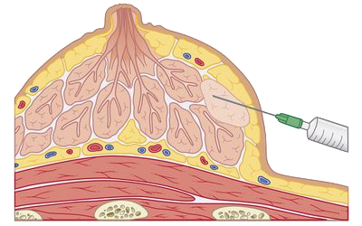
breast lump
syringe/needle
cross section

Slide 12
class 1
class 2
class 3
q classifiers to learn

Slide 13
class 1
class 2
class 3
O(q²) classifiers to learn.

Slide 14
class 1
class 2
class 3
D₁
D₂

Slide 15
1
2
3
or
3
2
1
1
3
2
or
2
3
1
D₂

Slide 17
class 1
class 2
class 3
D₁
D₂

Slide 18
class 1
Origin (x₁=0, x₂=0)
class 2
Dataset 1
Dataset 2
Dataset 3
x₂
x₂
x₂
x₁
x₁
x₁

